Slide 1

Statistics Final Project
杨茗语
丁子力
2023/5/26

Slide 2

Content summary
I: Proposal
II: College Life Guide
General
New York Traffic Guide
Food Delivery Guide
III. Academic & Activities:
Extracurricular Activities
Internships
Exploring Campus: Middlebury College Example
IV. Conclusion

Slide 3
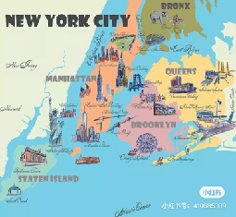
understand the local area's overall topography and urban distribution. According to the data collection and inquiry,
New York Traffic Guide
After knowing the main terrain, the next most important thing is to know how to get around, namely the mode of transportation. My college sister in New York City compiled this advice for me: Take a bus—— 1. The bus stop in New York is usually at the intersection of two streets and has a circle with a bus sign. Some station signs are electronic screens that show the estimated arrival time of buses.
2. Don't leave personal belongings in other empty Spaces, especially when the bus is crowded. 3. Through Request-A-Stop, you can ask the bus operator to drop you off from a non-bus stop route between 10 and 5 p.m. each night. 4. Tickets are about $2.75 and can be paid with the Metro Card. A non-disposable Metro card 5. You can transfer from subway to bus or bus to bus for free within two hours.

Slide 4

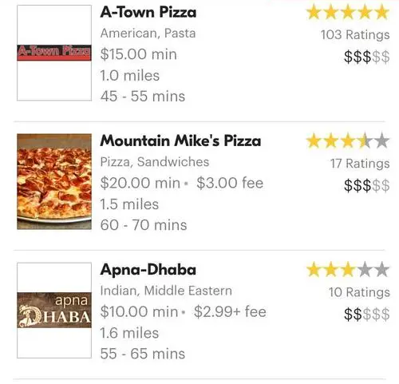
Food Delivery Guide
When it comes to college life, it is also necessary to know about the food near the school. In order to better "enjoy" college life, I found a local delivery software to "enjoy" in advance.
Uber Eats
DoorDash
Chinese restaurant telephone

Slide 5

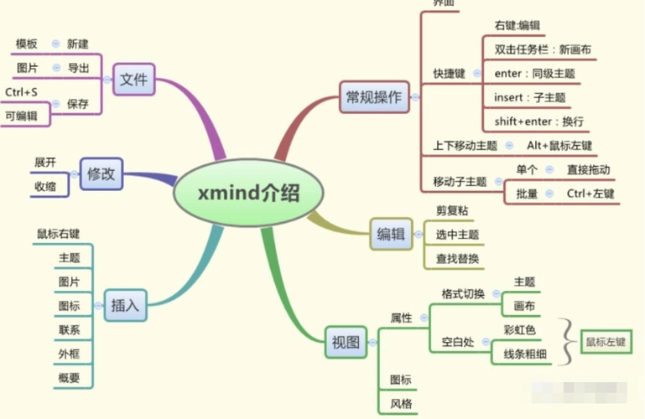
Other practical app summaries
Lstudiez Pro
Evernote:
xMind:
My Homework Student Planner
My Study Life

Slide 6
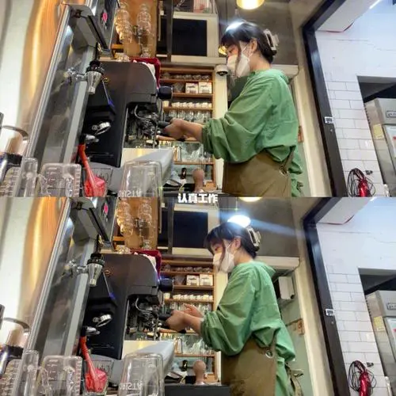
Academic & Activities:
College life is a transformative period that presents numerous opportunities for personal and professional growth. This comprehensive guide aims to provide valuable insights and practical tips for maximizing your college experience, including engaging in academic research, participating in fulfilling extracurricular activities and securing impactful internships.
Exploring Your Interests
Leadership Roles and Skill Development:
Community Engagement
Personal Growth and Wellness
Student Handbook and Online Resources
Engaging with Student Organizations
Seeking Mentorship and Connecting with Upperclassmen

Slide 7

Conclusion
By following the advice and strategies outlined in this college life guide, we hope that you can gain some useful knowledge of how to make the most out of college life, not only academically but also having a fulfilling and enjoyable college experience.

